Slide 1
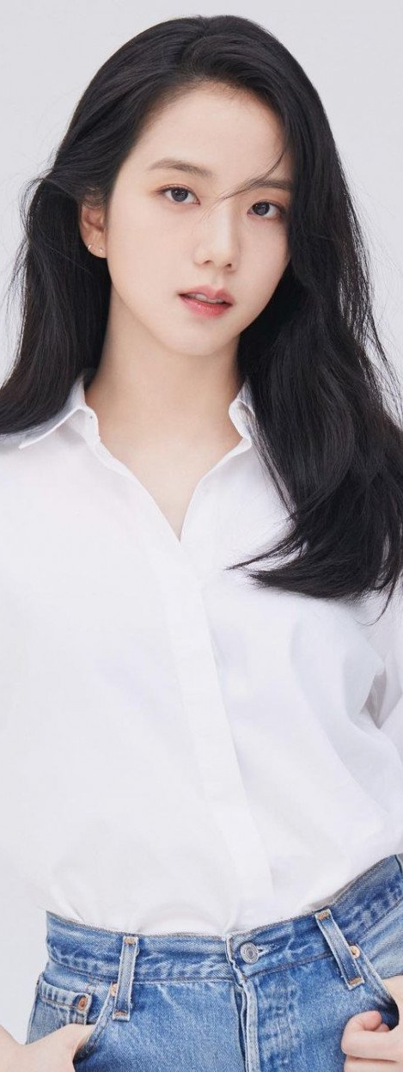
BIO
Jisoo is an avid hiker who spends most of her weekends hiking with her friends. She spends more than 6 hours on each hike and hike a few times a month. Jisoo strives to improve her health while at the same enjoying taking pictures of the flora and fauna, and beautiful landscape sceneries throughout her hiking journey. She loves to share her hiking photos on social media and would also love to join a hiking community to socialize and interact with other hikers. She has used hiking apps for her hiking journey, but she found these hiking apps to be too complex to use and lack of community interactions.
Motivations
Skills
Fitness and health - improving health
Photography - taking photos of hiking scenery
Social engagement - socialize and interacting with others
Destress - getting away from work
Photography
Experience with hiking apps
Proficiency in reading
topographic map
Proficiency in reading online map
Social engagement
Lee Jisoo
Goals
Frustrations
22, Selangor, Malaysia
Improving health and fitness
Taking good hiking sceneries
Interacting and socializing with other hikers
Destress from hectic work through hiking
Customizing own user profile
View other hiker’s user profile
Unsure of what equipment to bring when hiking
Lack of information of the condition of hiking trails
Lack of community engagement from previous hiking applications
Lack of information for the best time and whether condition for hiking
STUDENT
^{NATIONALITY: MALAYSIAN}
^{MARITAL STATUS: SINGLE}
^{EMPLOYMENT: STUDENT}
^{FIELD OF EMPLOYMENT: STUDENT}

Slide 2
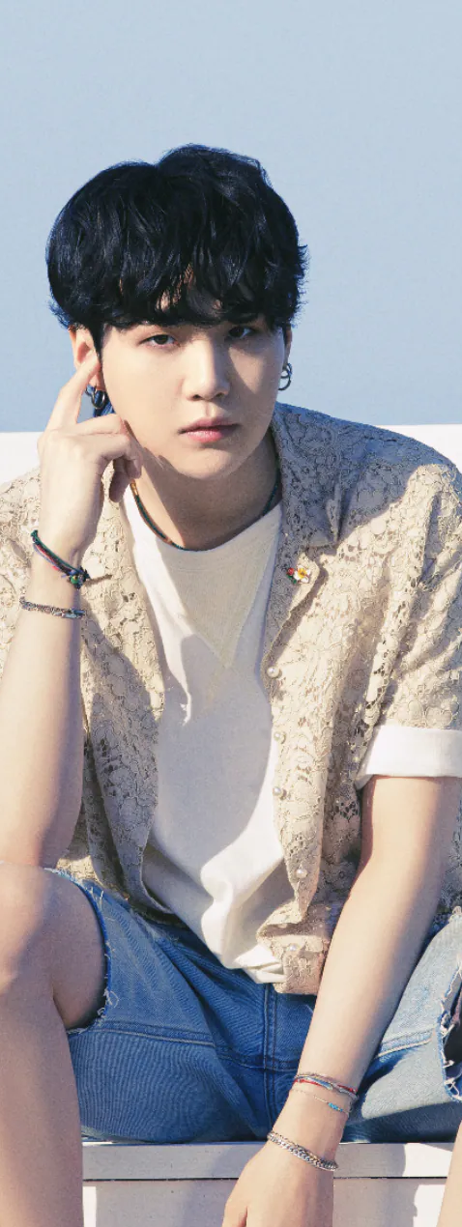
BIO
Wai Kit is a student who takes good care of his health and loves to take photos of hiking sceneries such as Sunset photos, Landscape photos and more. He is an outgoing person and is willing to make friends by interacting with other on his hiking journey.
Despite his busy schedule as a student who is majoring in HealthCare and Medicine, Wai Kit still make it a priority to plan hiking trips throughout the year.
Wait Kit also has a passion for photography where he utilizes his smartphone camera and his favorite DSLR camera to take photos and uploads them on social media.
Overall, Wai Kit is a casual hiker and photographer who focuses on his health, has a passion for photography and an outgoing person who likes to make new friends.
Motivations
Skills
Photography - taking photos hiking scenery
Social engagement - socializing and interacting with others
Nature and Adventure - exploring the outdoors
Fitness and health - improving overall health
Photography
Experience with hiking apps
Proficiency in reading
topographic map
Proficiency in reading online map
Social engagement
Lee Wai Kit
Goals
Frustrations
23, Selangor, Malaysia
Finding new friends by connecting with other hikers, and plan hiking trips together
Taking good photos of hiking sceneries through the hiking journey
Improving fitness and health
Share hiking photos and experiences with others
Lack of community engagement from previous hiking applications
Previous hiking apps are too complex to use
Outdated information of the hiking trails
STUDENT
^{NATIONALITY: MALAYSIAN}
^{MARITAL STATUS: SINGLE}
^{EMPLOYMENT: STUDENT}
^{FIELD OF EMPLOYMENT: STUDENT}

